Slide 1
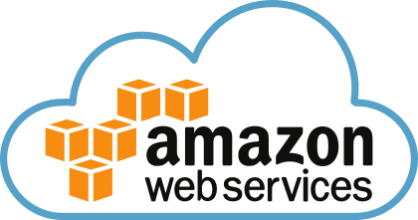
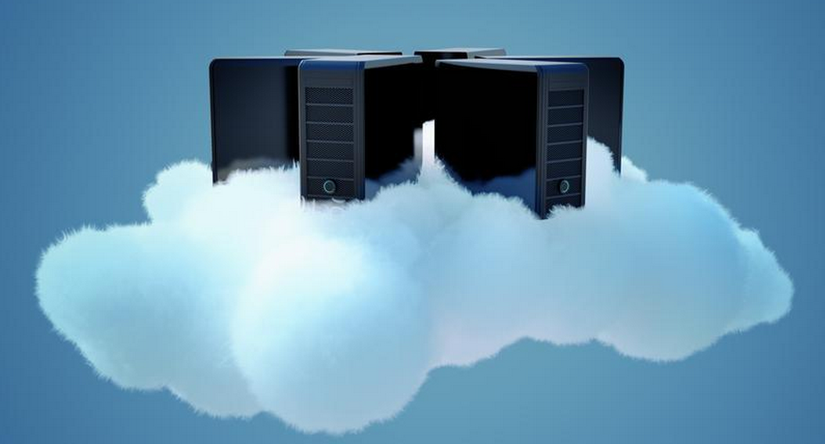

AWS Training - Session 5
Dr. Prabhakar PhD
Senior Integration Engineer
Decision Minds, Bengaluru.

Slide 2
Contents
Virtual Private Network (VPC) – Part I

Slide 3
VPC is a logical data centre
The list of AWS services that can be used with Amazon VPC are −
Amazon EC2
Amazon Route 53
Amazon WorkSpaces
Auto Scaling
Elastic Load Balancing
AWS Data Pipeline
Elastic Beanstalk
Amazon Elastic Cache
Amazon EMR
Amazon OpsWorks
Amazon RDS
Amazon Redshift

Slide 4
AWS Region
Subnet 1 (Public)
VPC
10.0.0.0/16
Route Table
Network ACL
10.0.1.0/24
EC2
Instance
EC2
Instance
Security Group
Internet Gateway
Router
Subnet 2 (Private)
Route Table
Network ACL
EC2
Instance
EC2
Instance
Security Group
10.0.2.0/24

Slide 5
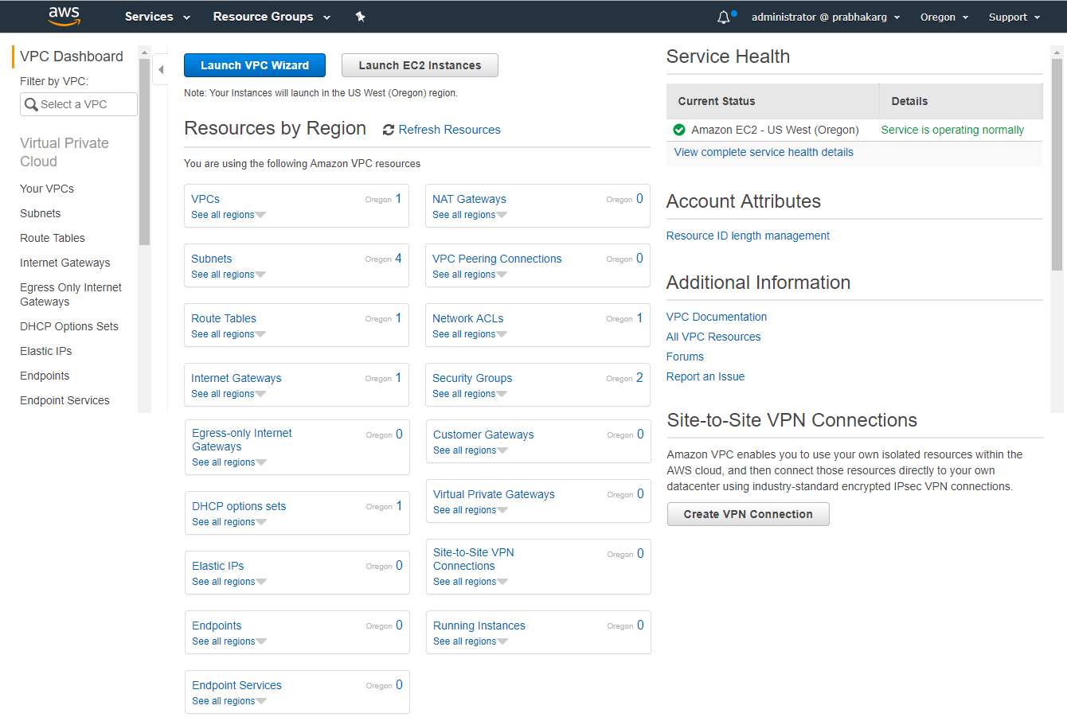

Slide 6
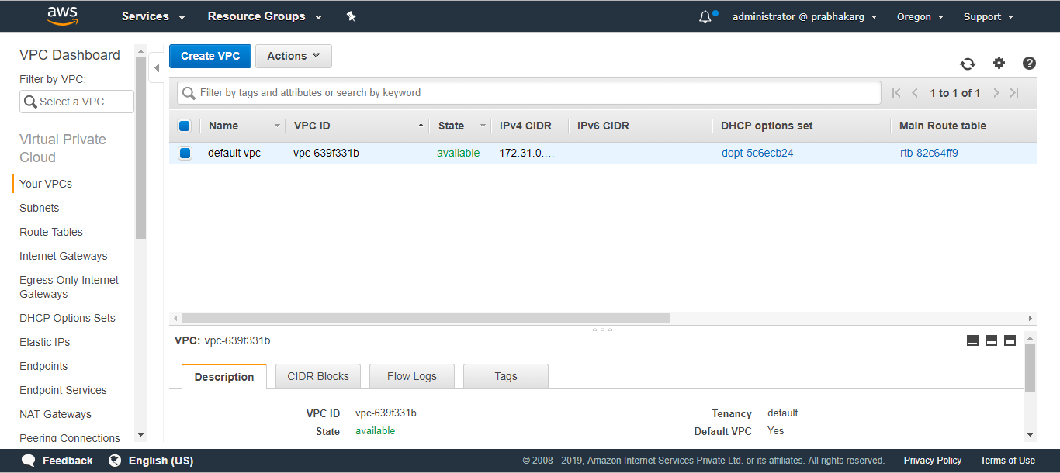

Slide 7
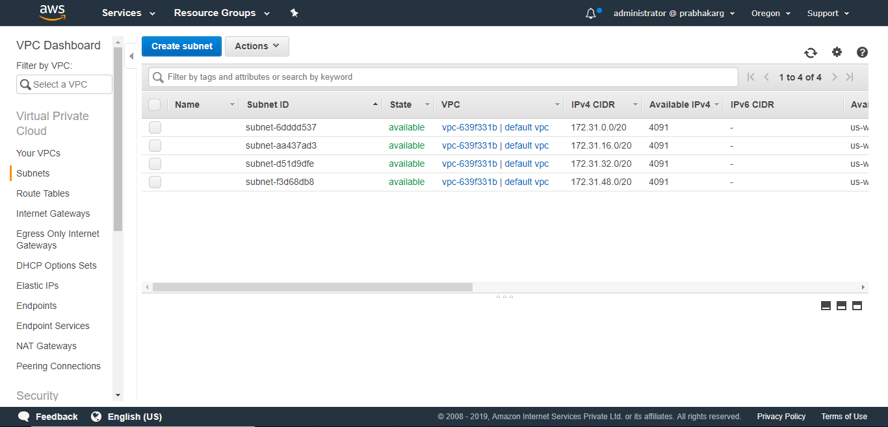

Slide 8
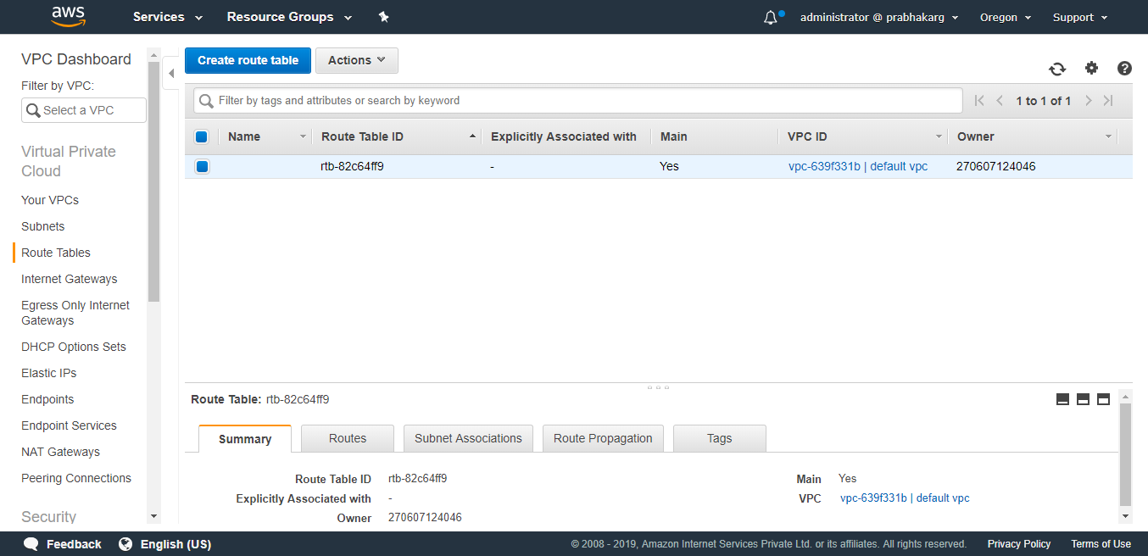

Slide 9
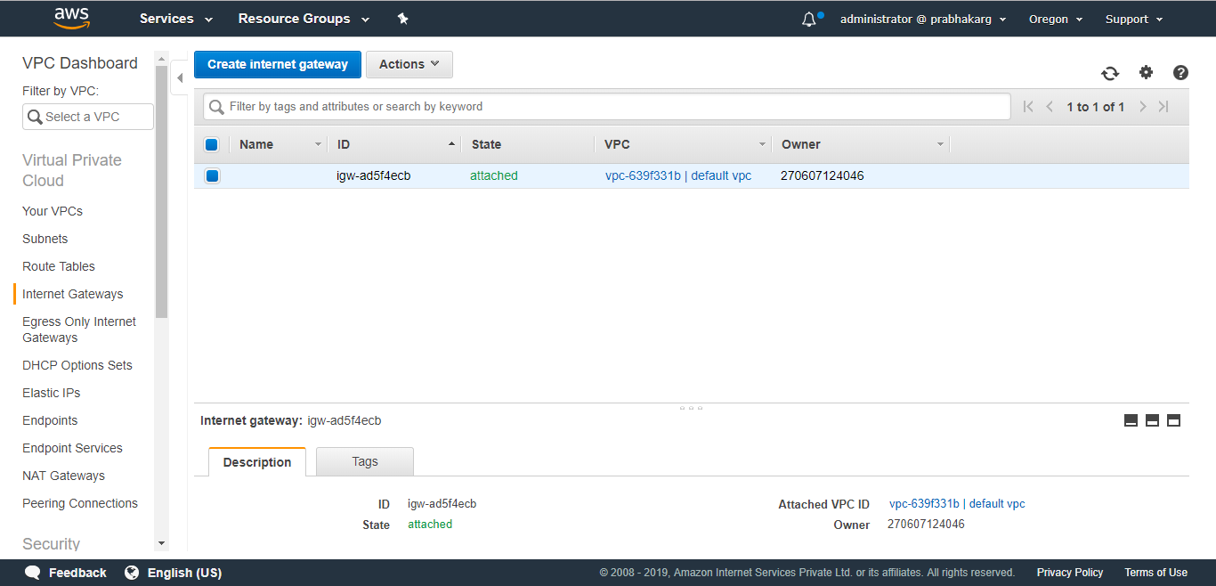

Slide 10
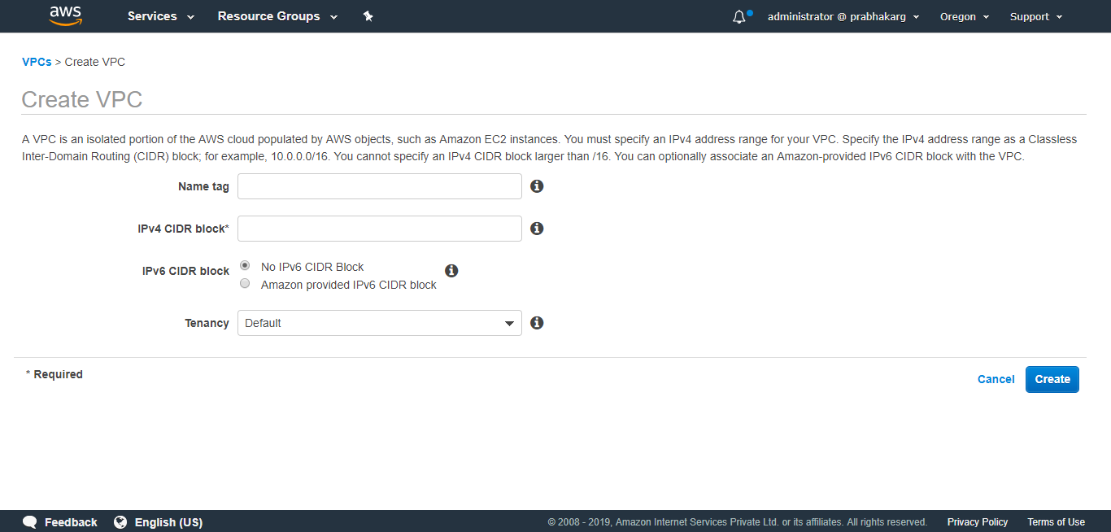

Slide 11
Classless Inter-Domain Routing
10.0.0.15/24. This means that the first 24 bits of the IP address given are considered significant for the network routing.
Class | Netmask length | # of networks | # of hosts | Netmask
Class A | 8 | 126 | 16,777,214 | 255.0.0.0
Class B | 16 | 16,382 | 65,534 | 255.255.0.0
Class C | 24 | 2,097,150 | 254 | 255.255.255.0

Slide 12
 | Addresses | Hosts | Netmask
/30 | 4 | 2 | 255.255.255.252
/29 | 8 | 6 | 255.255.255.248
/28 | 16 | 14 | 255.255.255.240
/27 | 32 | 30 | 255.255.255.224
/26 | 64 | 62 | 255.255.255.192
/25 | 128 | 126 | 255.255.255.128
/24 | 256 | 254 | 255.255.255.0
/23 | 512 | 510 | 255.255.254.0
/22 | 1024 | 1022 | 255.255.252.0
/21 | 2048 | 2046 | 255.255.248.0
/20 | 4096 | 4094 | 255.255.240.0
/19 | 8192 | 8190 | 255.255.224.0
/18 | 16384 | 16382 | 255.255.192.0
/17 | 32768 | 32766 | 255.255.128.0
/16 | 65536 | 65534 | 255.255.0.0

Slide 13
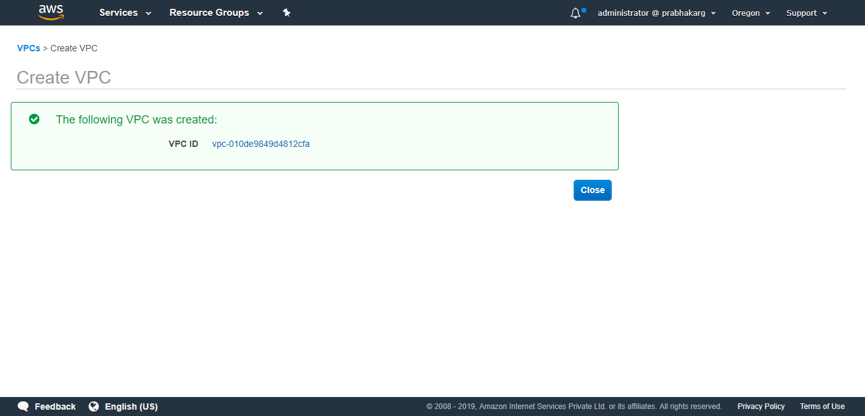

Slide 14
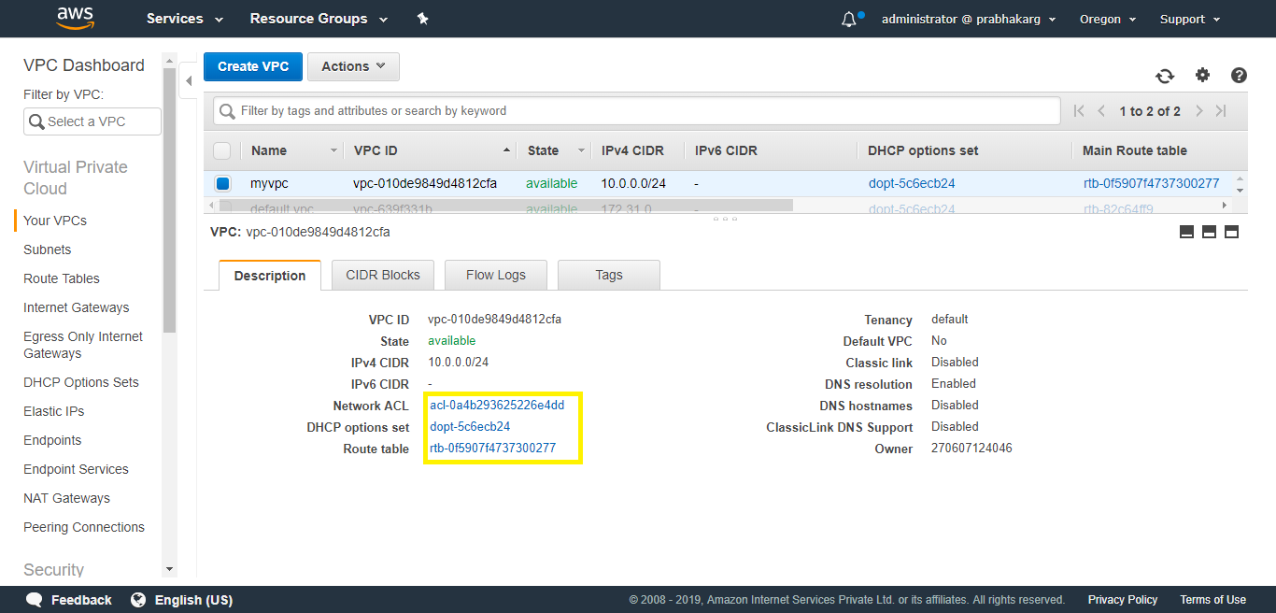

Slide 15
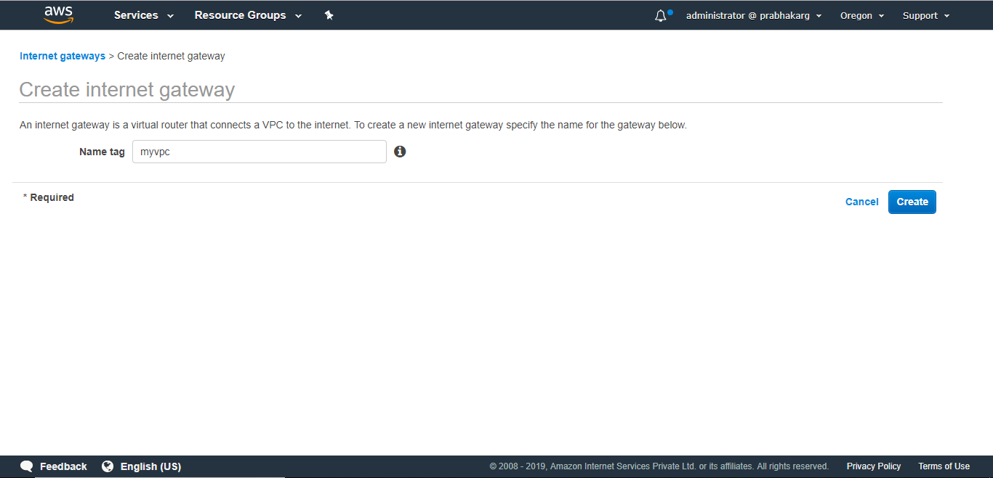

Slide 16
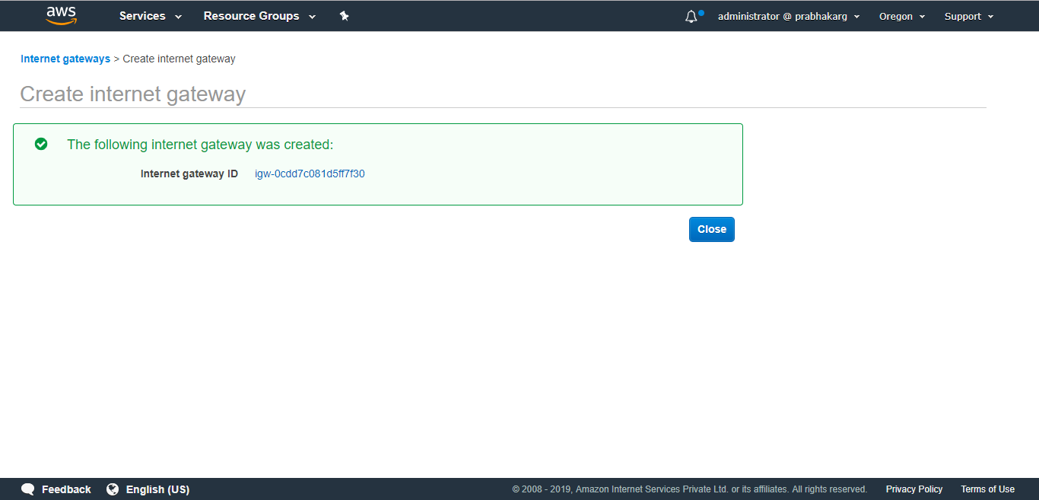

Slide 17
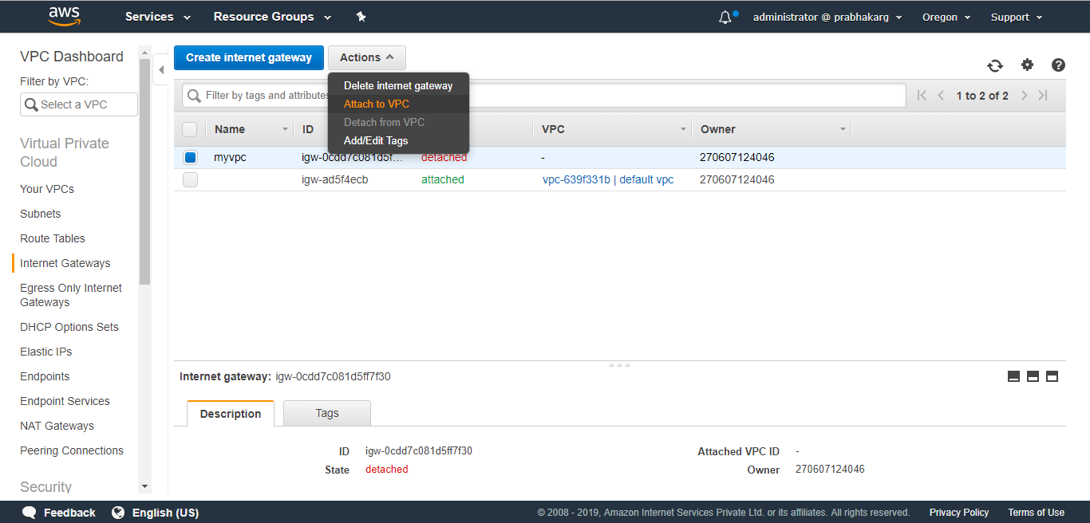

Slide 18
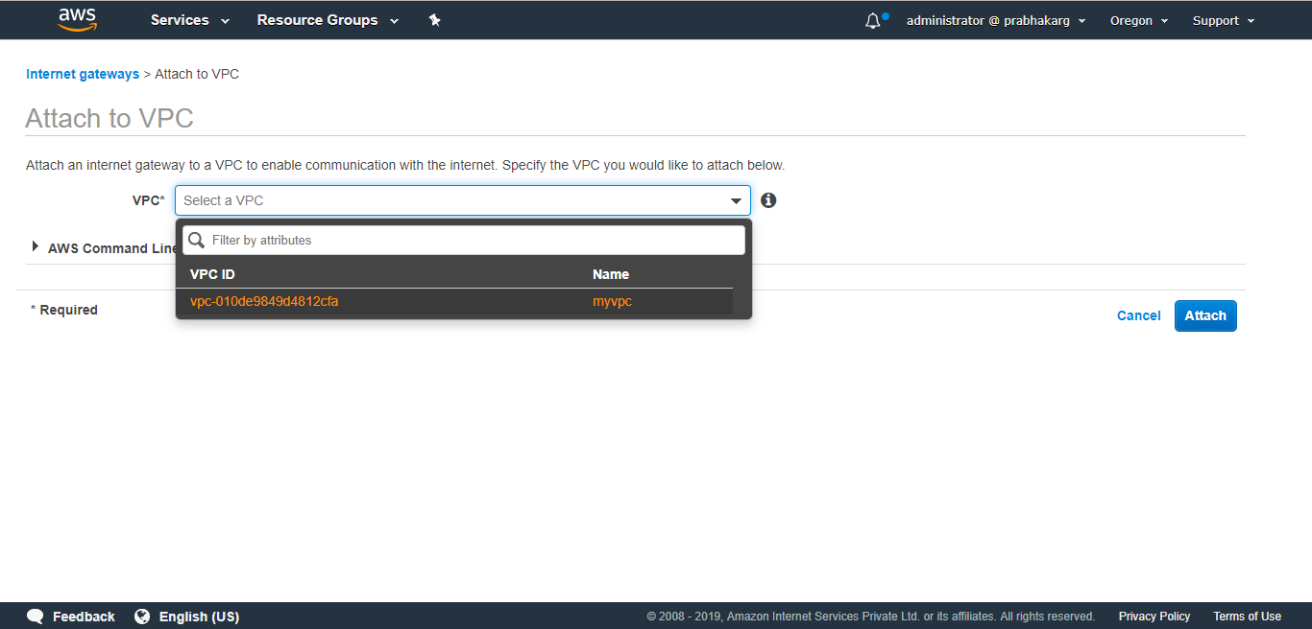

Slide 19
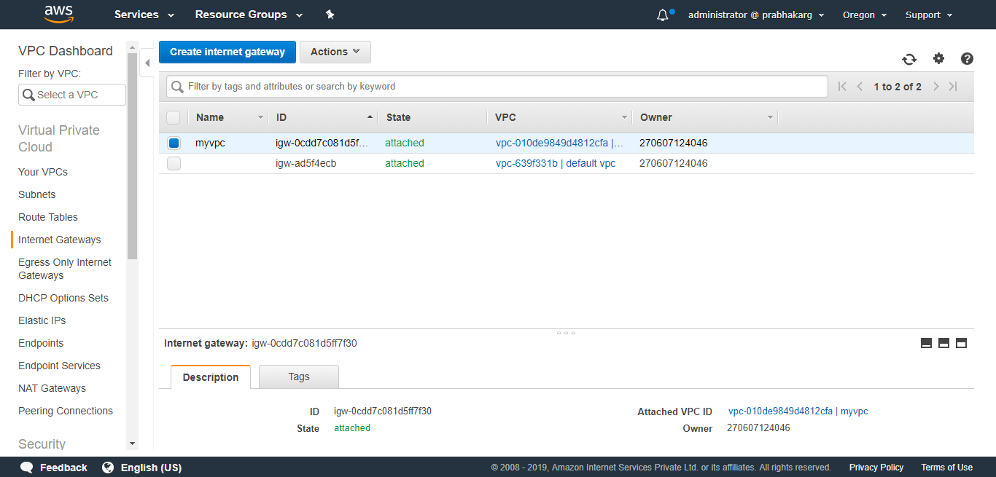

Slide 20
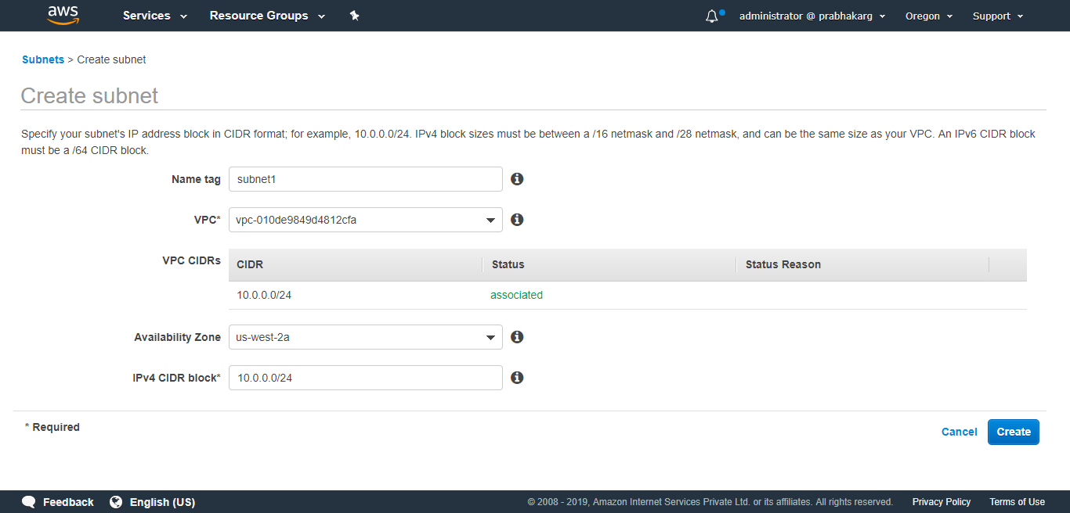
Subnet Creation (Public)

Slide 21
Subnet Creation (Private)

Slide 22
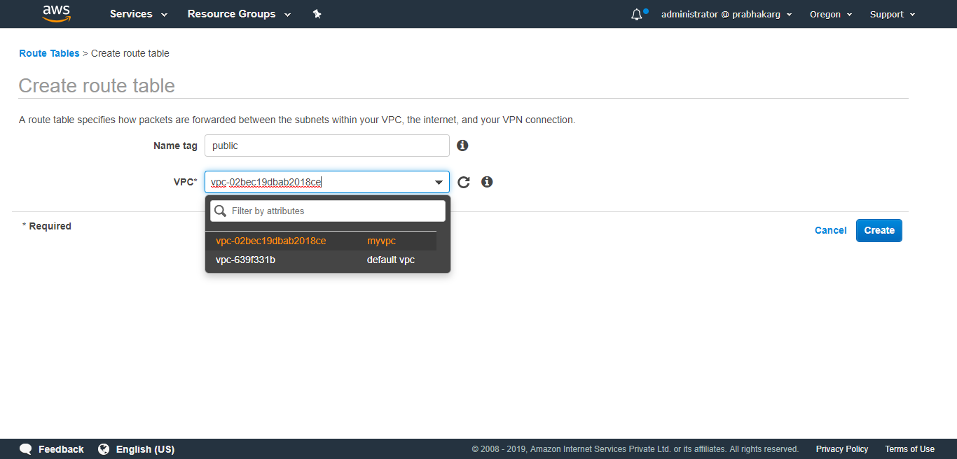

Slide 23
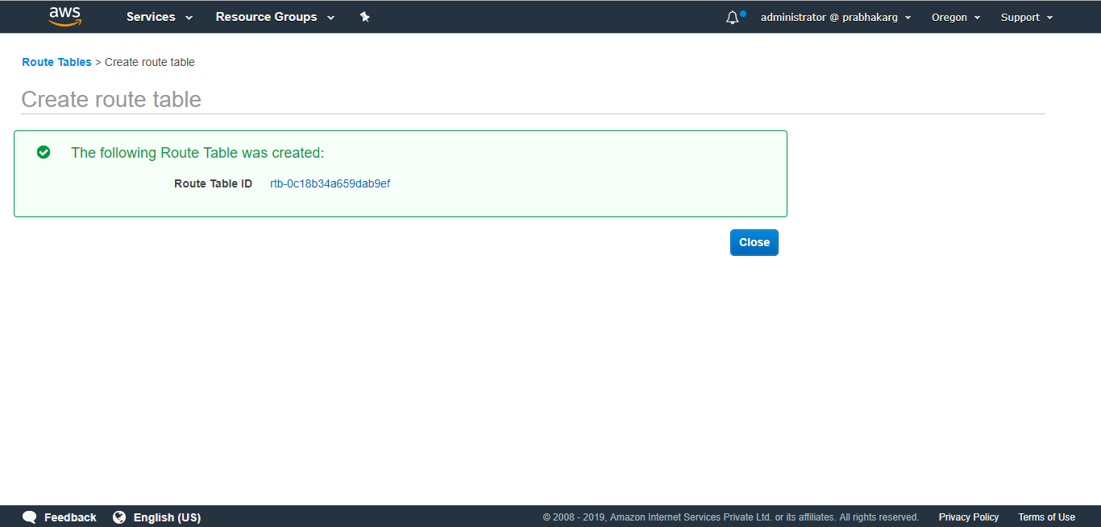

Slide 24
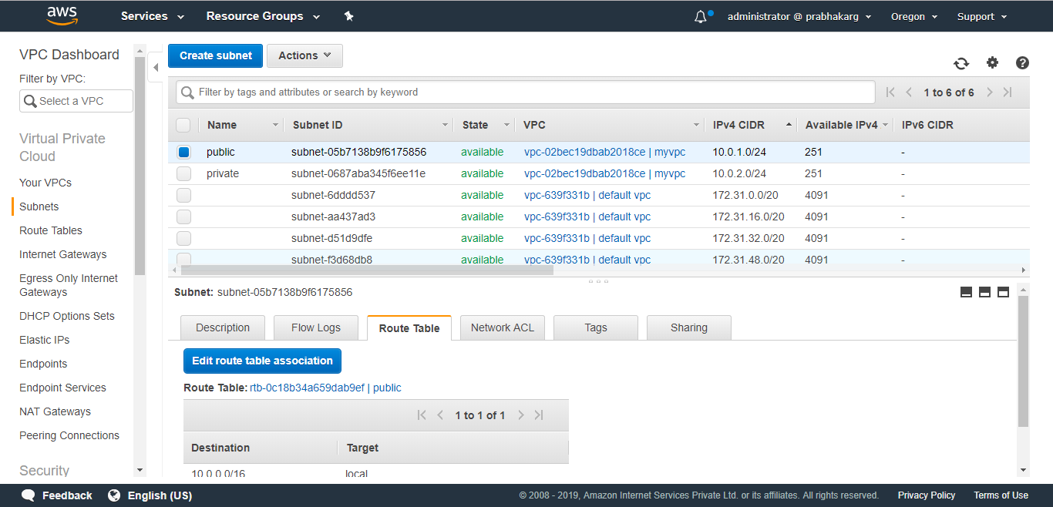

Slide 25
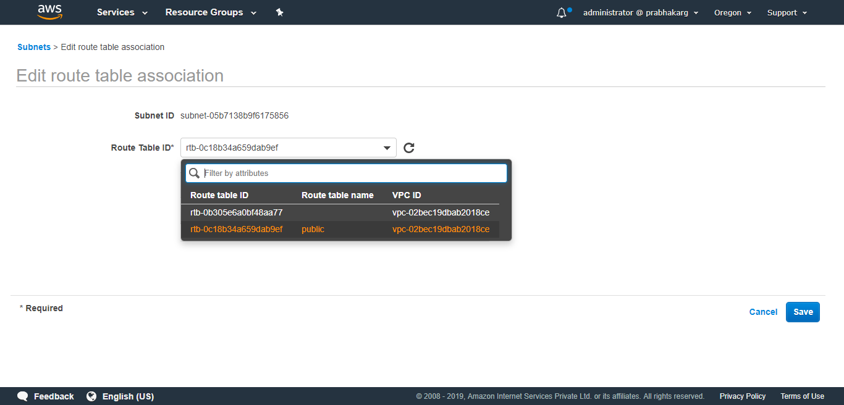

Slide 26
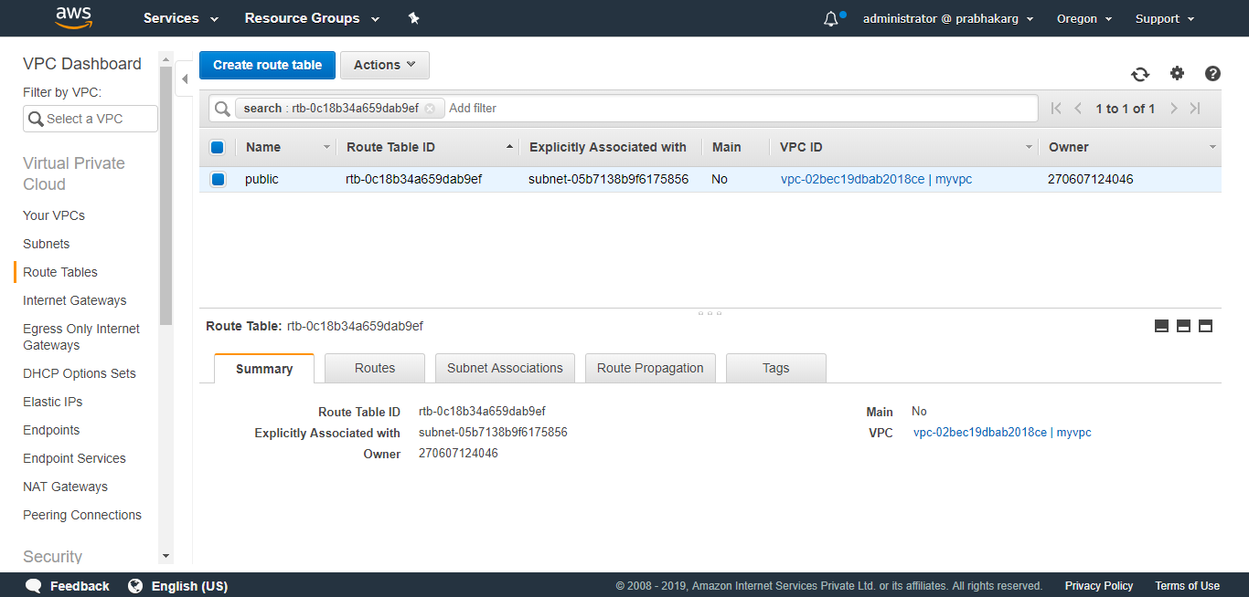

Slide 27
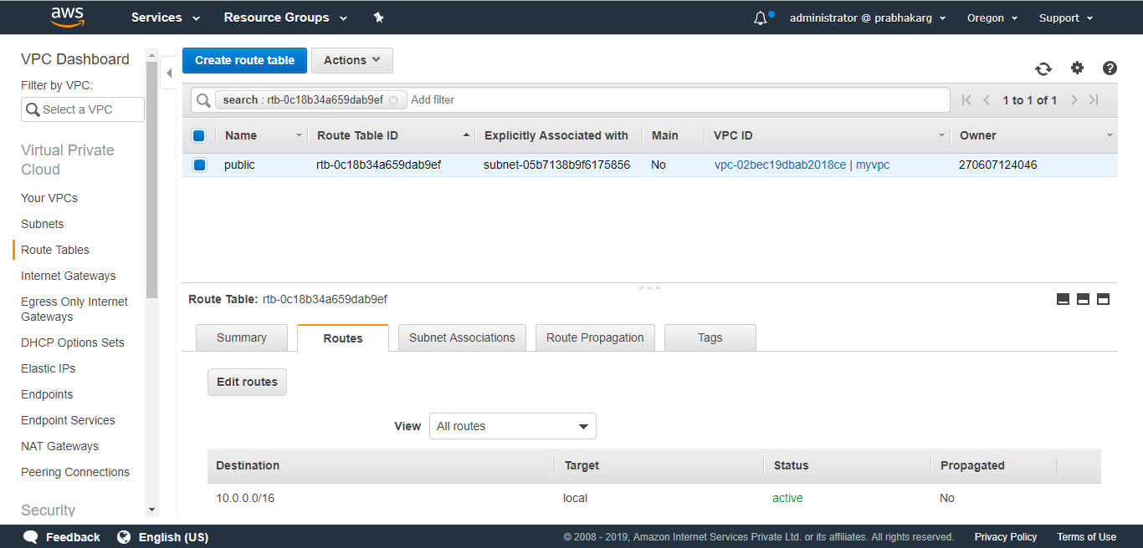

Slide 28
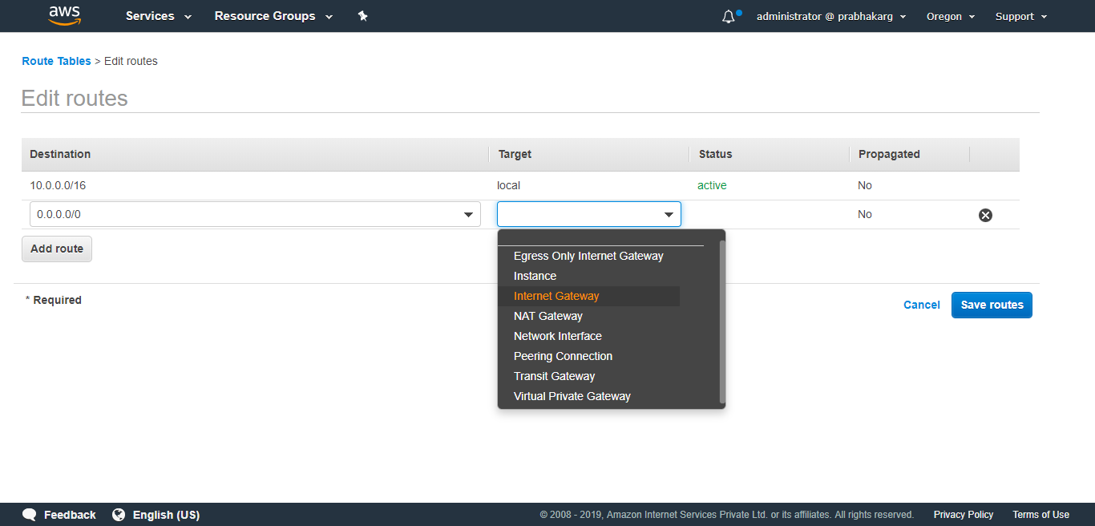

Slide 29
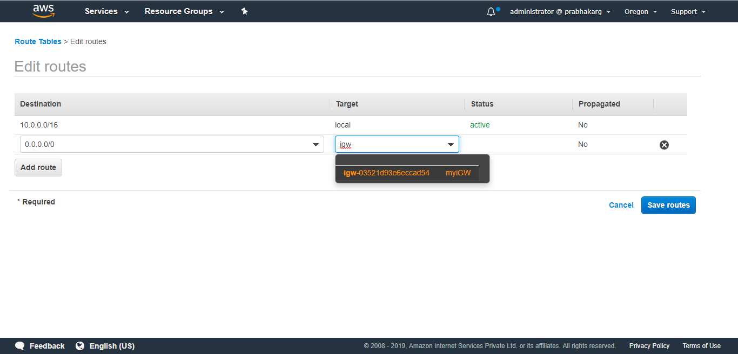

Slide 30
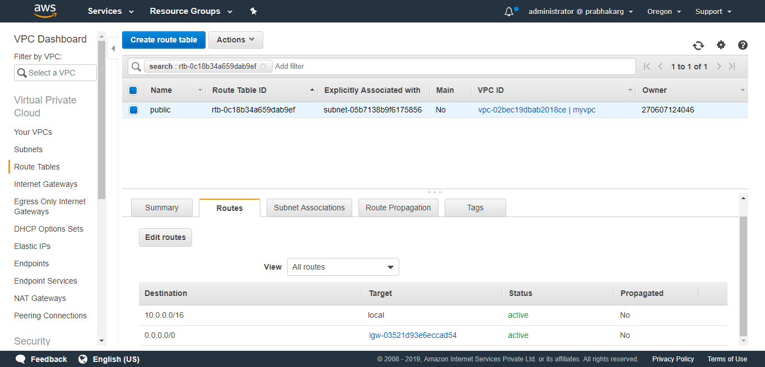

Slide 31
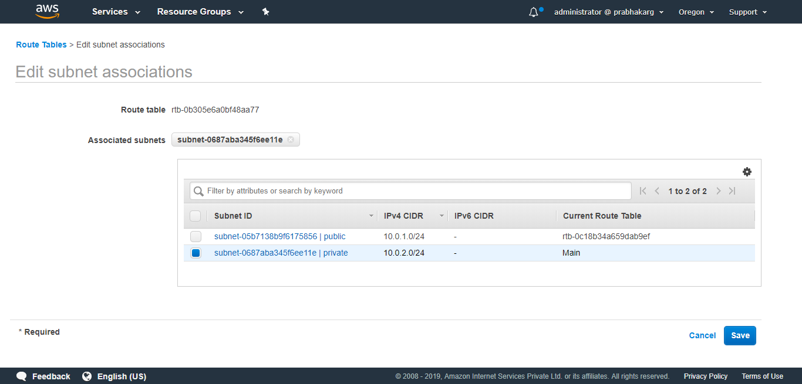

Slide 32
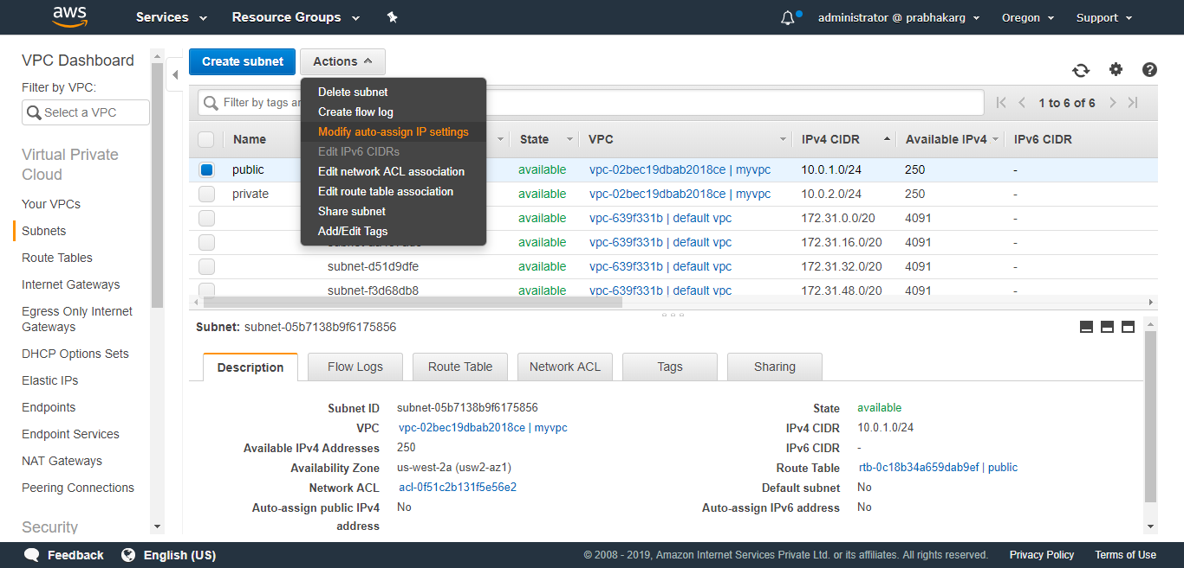

Slide 33
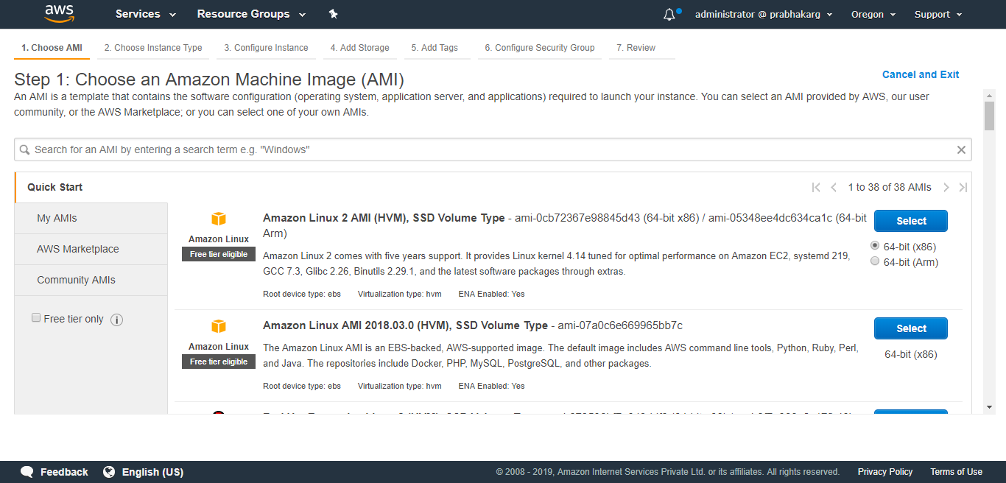

Slide 34
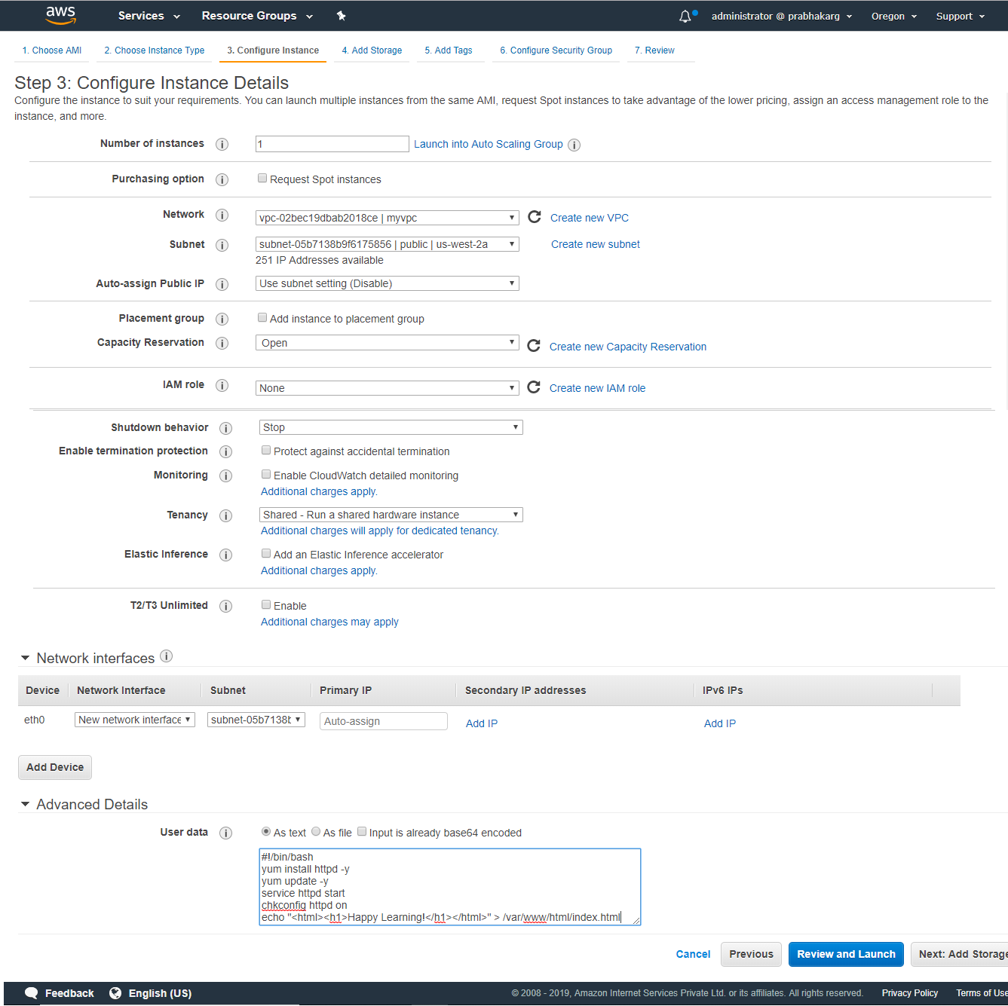

Slide 35
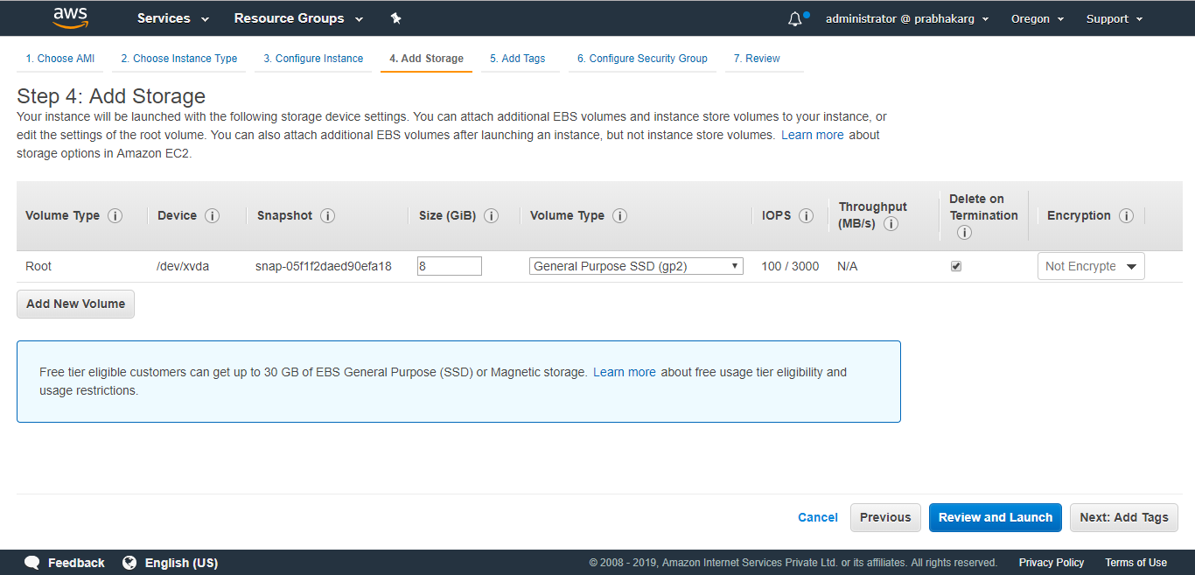

Slide 36
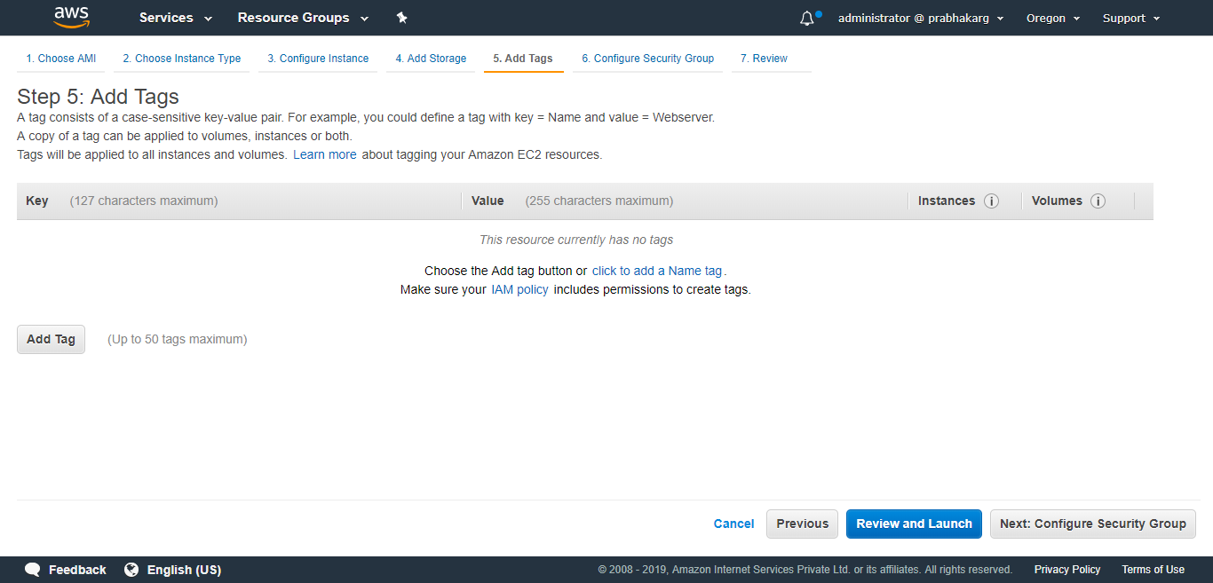

Slide 37
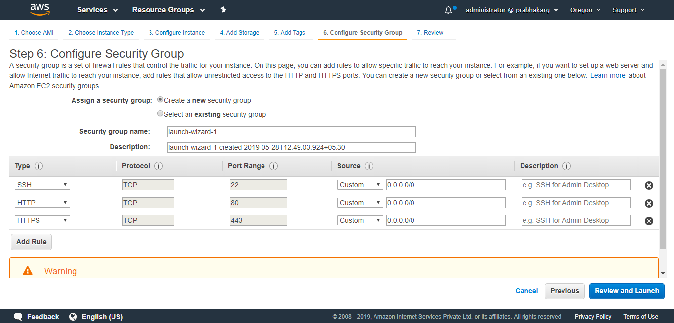

Slide 38
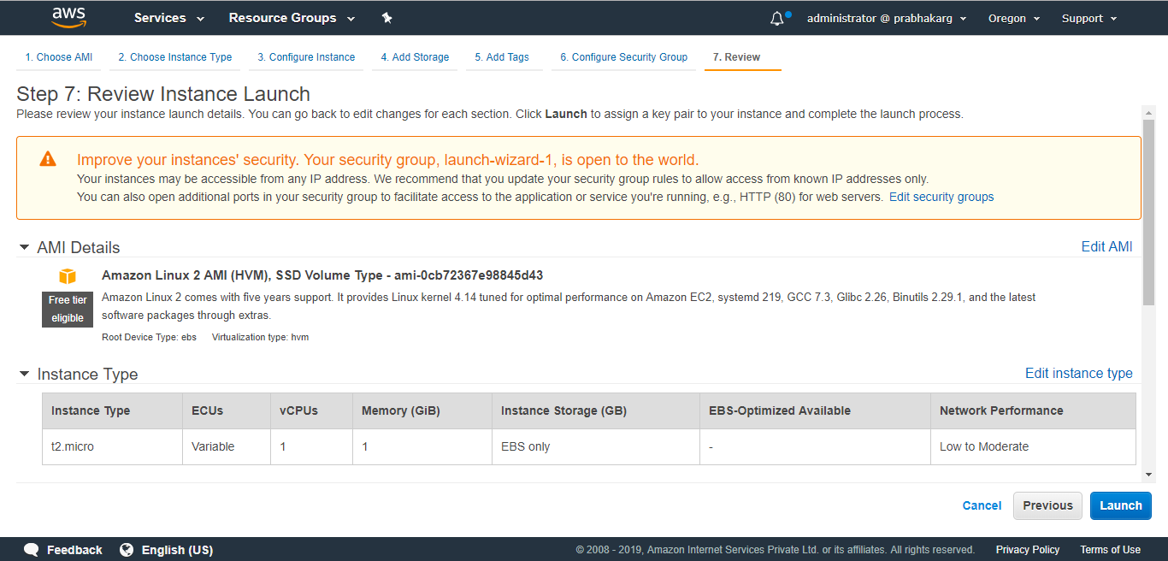

Slide 39
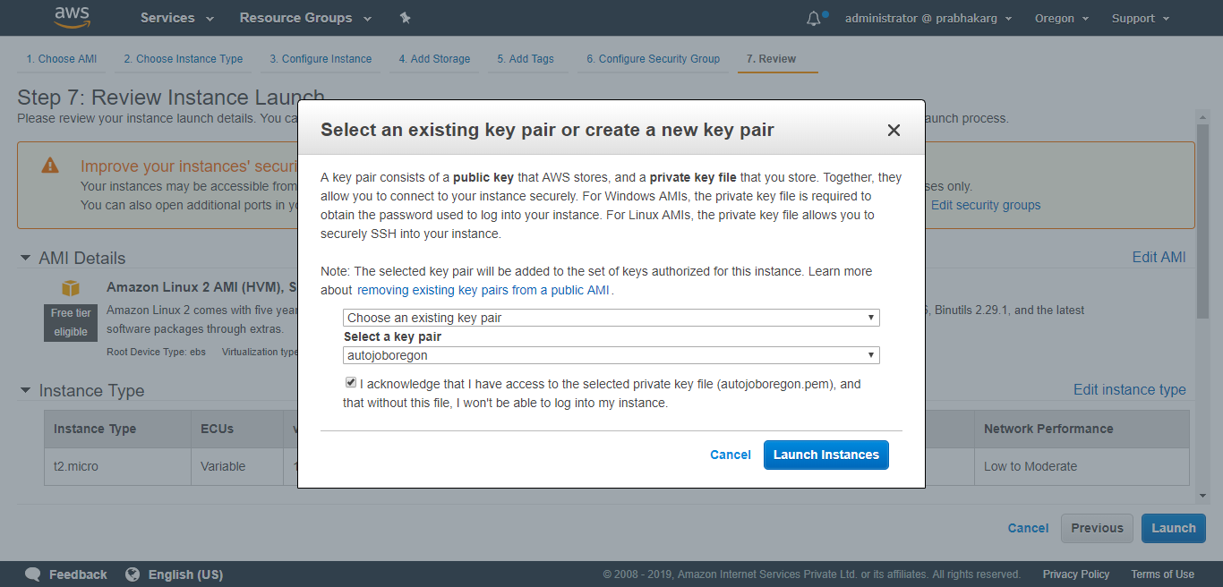

Slide 40
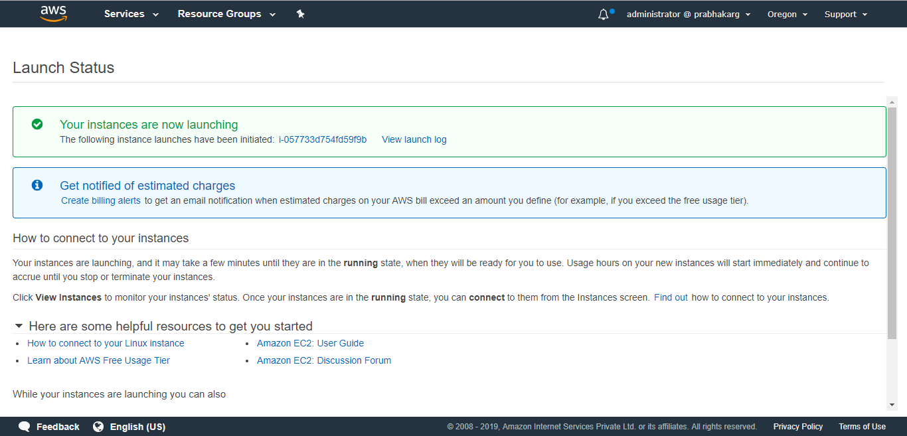

Slide 41
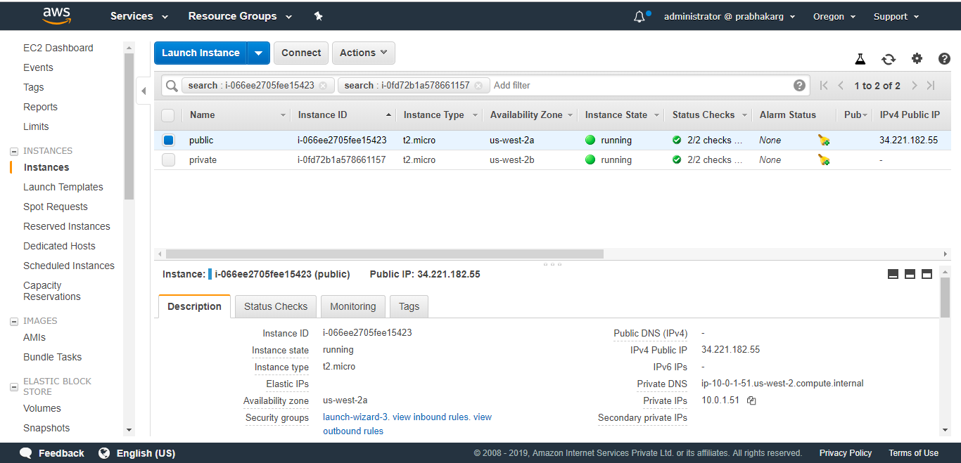
Similarly launch an instance in the private subnet

Slide 42
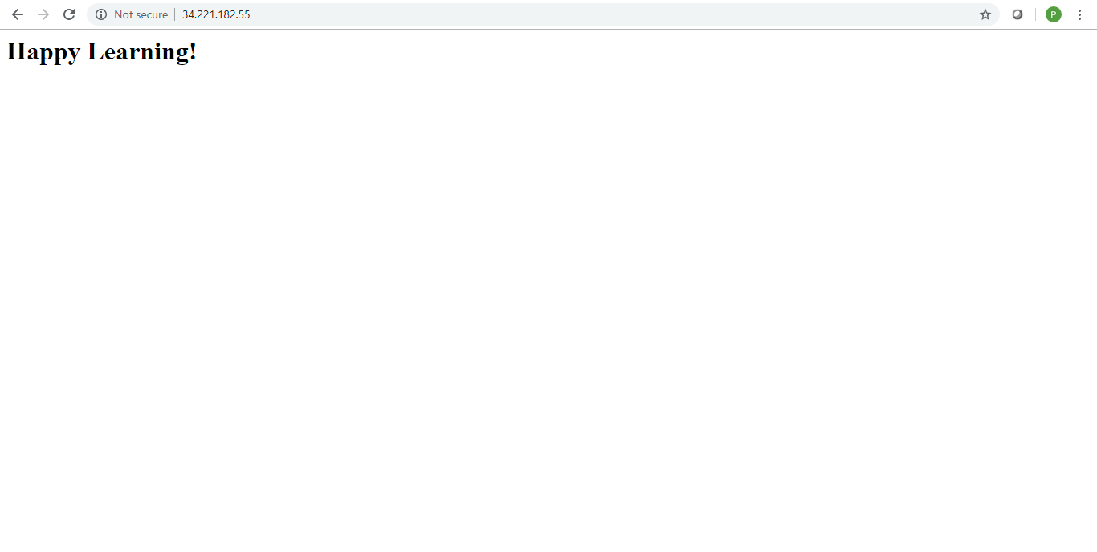

Slide 43
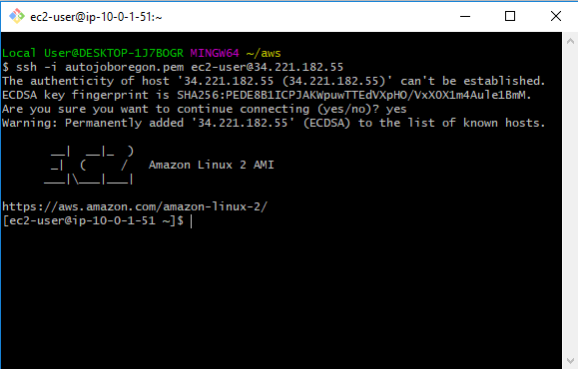
Connecting to Instance in Public Subnet

Slide 44
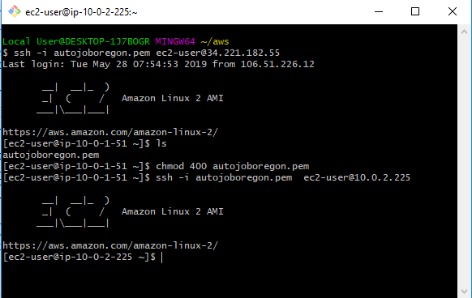
Connecting to Instance in Private Subnet Through Private Subnet

Slide 45
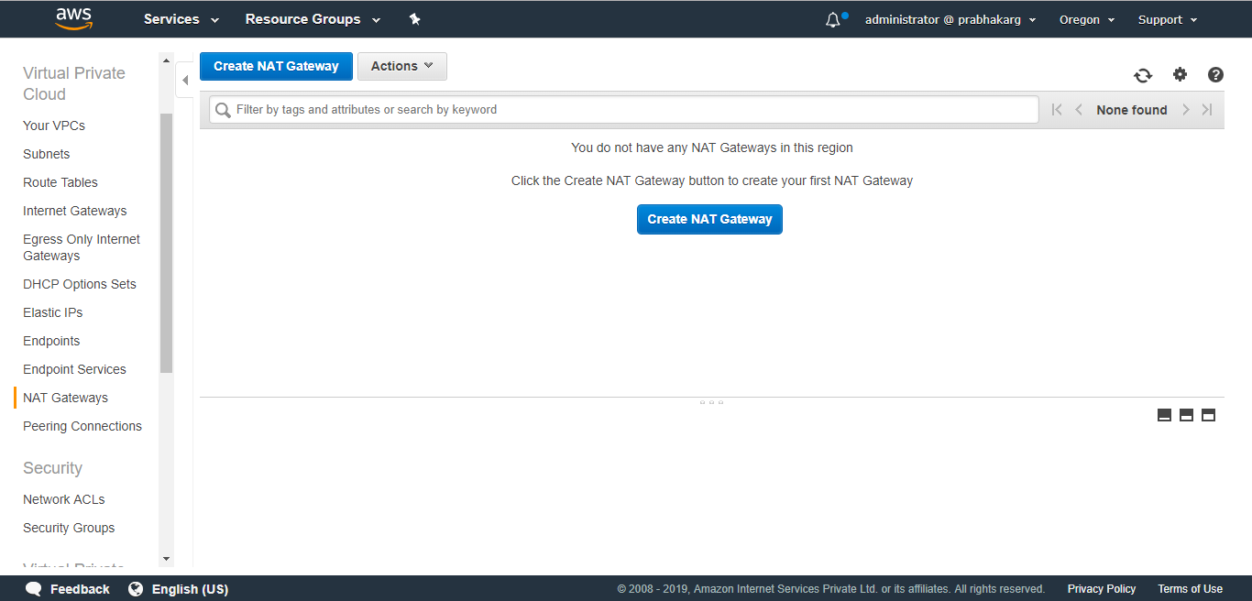

Slide 46
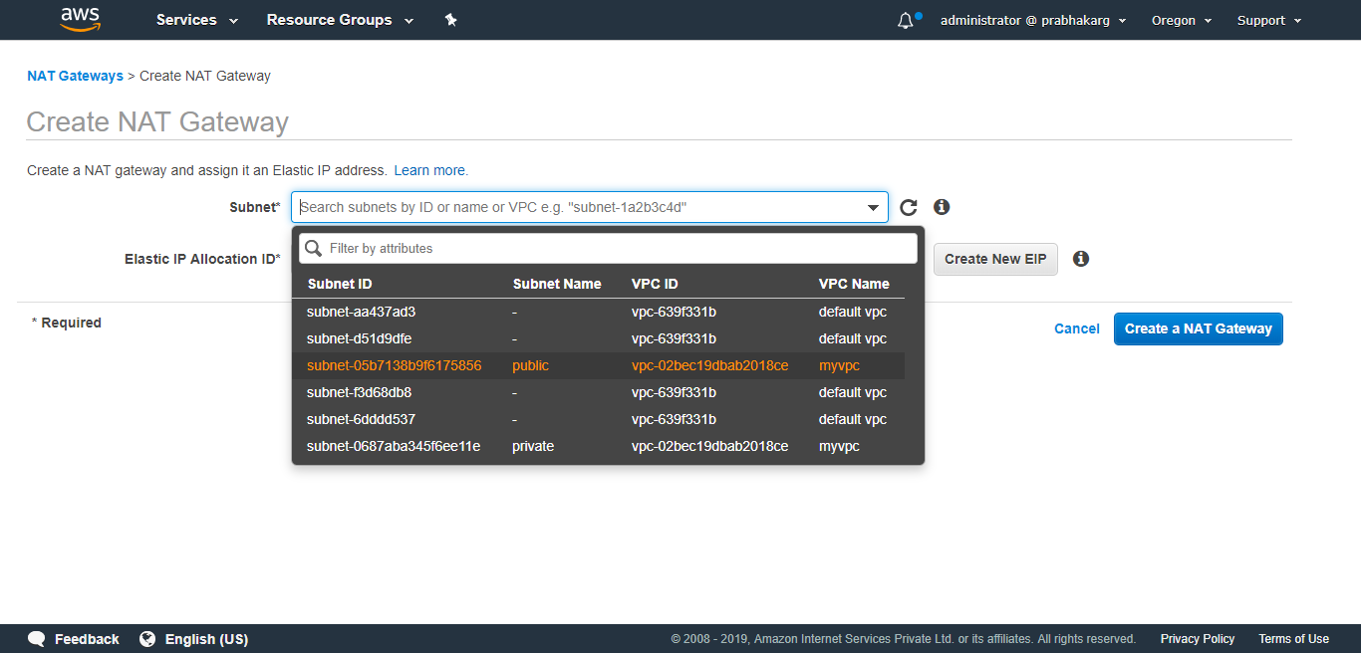

Slide 47
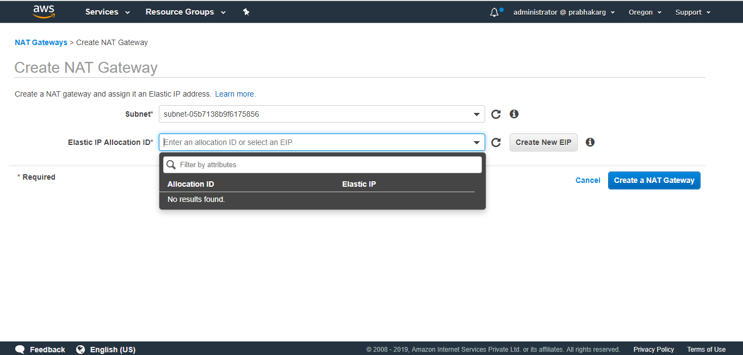

Slide 48
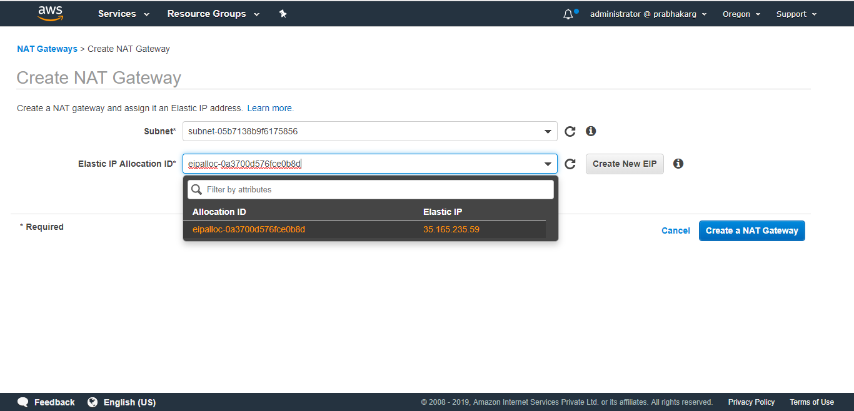

Slide 49
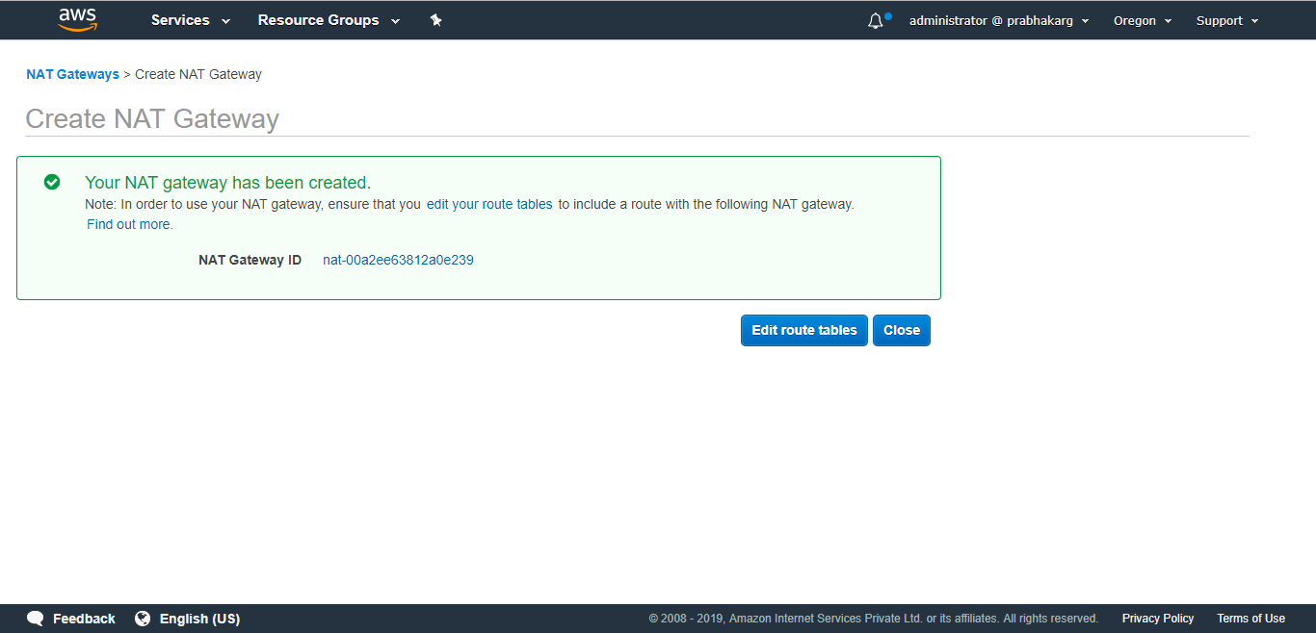

Slide 50
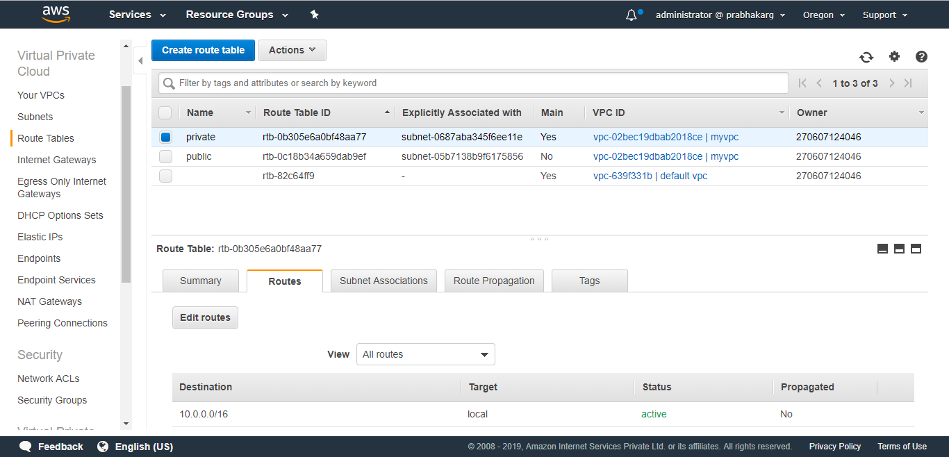

Slide 51
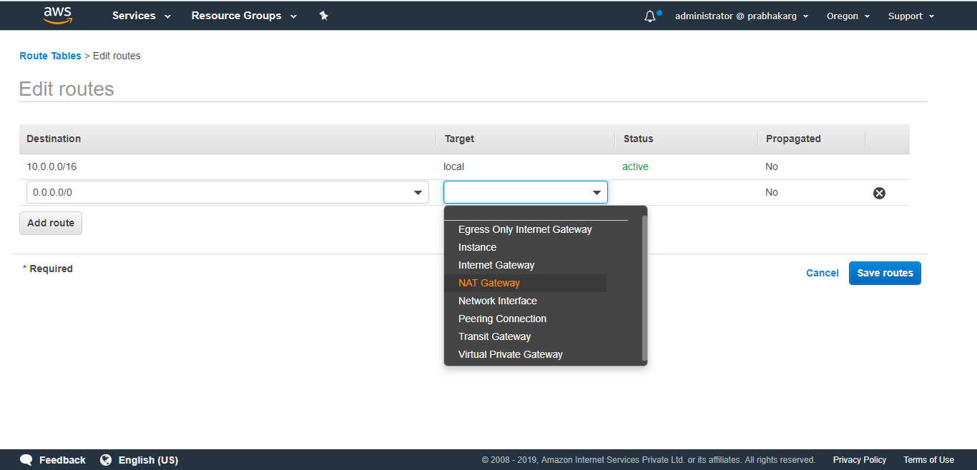

Slide 52
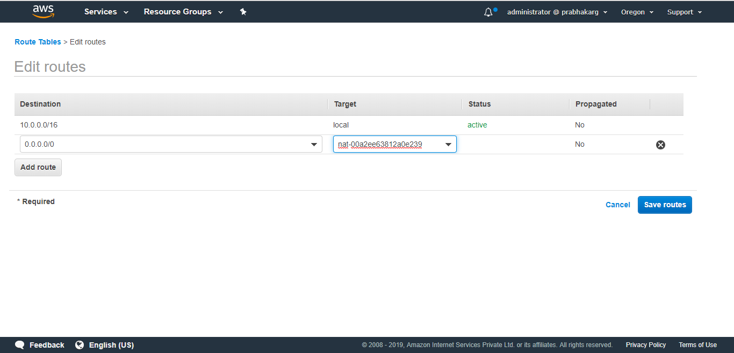

Slide 53
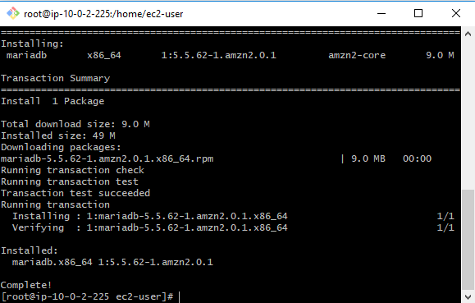

Slide 54
Coming Up
Elastic Compute Cloud Part III
Virtual Private Cloud AWS VPC II
Thank you

